Slide 1


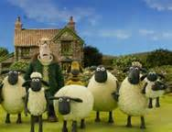

Look at teacher 看着老师 Kànzhe Lǎoshī
Listen to teacher 听老师说 Tīng Lǎoshī shuō
Answer teacher 回答老师 Huídá Lǎoshī
Be quiet 安靜 Ānjìng
Sit down 坐下 Zuò xià
Neil Teacher
外國老師
Wàiguó lǎoshī
You follow the rules and
we have fun & watch video
你遵循规则，我们玩得开心 + 观看视频..
Nǐ zūnxún guīzé,
wǒmen wán dé kāixīn + guānkàn shìpín
Shaun the sheep
小羊肖恩

Slide 2
Hello!

Slide 3

What do you hear?
I hear
a teacher

Slide 4

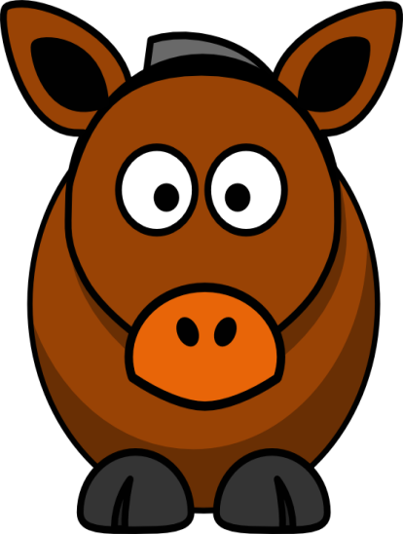
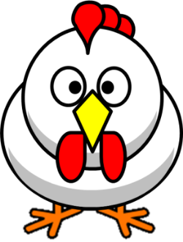

?
moo

Slide 5

I hear a lion
roar

Slide 6

I hear a sheep
baa

Slide 7
I hear a hen
cluck

Slide 8

I hear a dog
woof

Slide 9
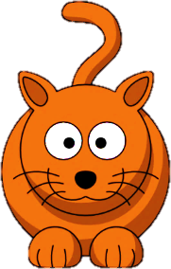
I hear a cat
meow

Slide 10
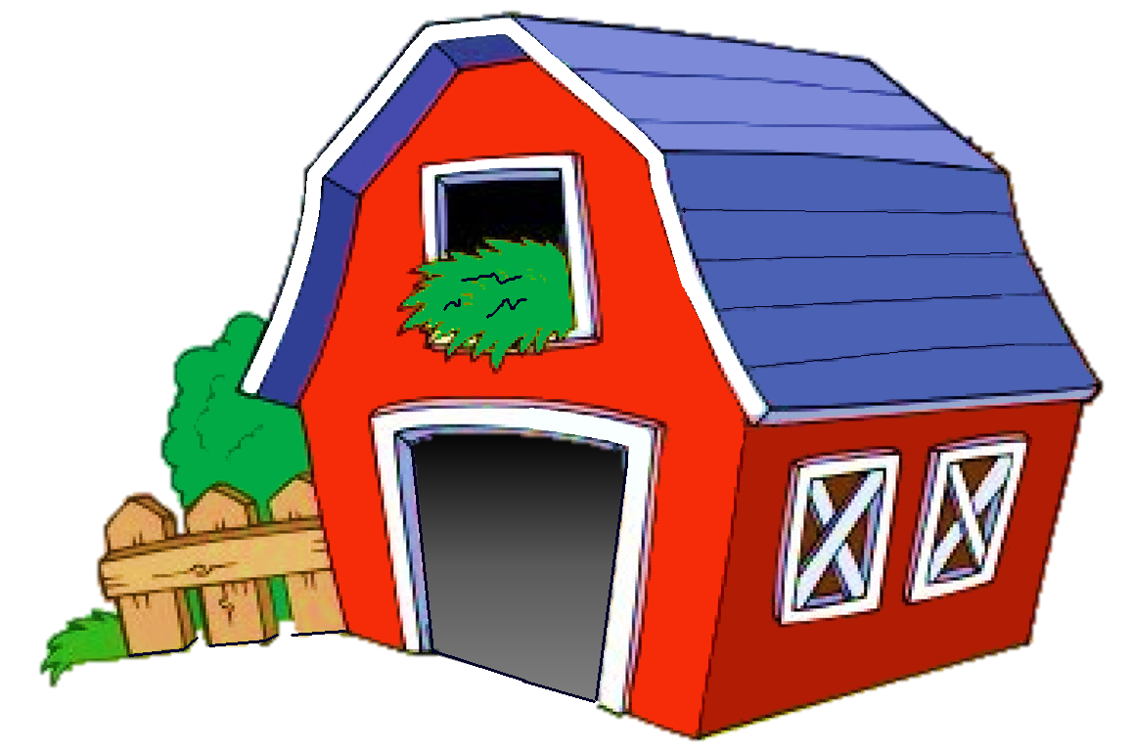
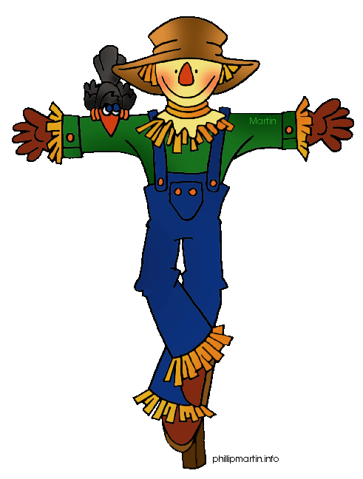
Lets play a game
NEXT

Slide 11


Sheep …
1 moo
2 oink
3 baa
Click on the right word

Slide 12
Dogs …
1 oink
2 moo
3 woof
Click on the right word

Slide 13
Cats …
1 moo
2 meow
3 woof
Click on the right word

Slide 14
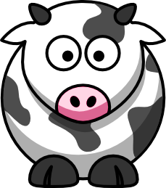
Cows …
1 oink
2 moo
3 woof
Click on the right word

Slide 15
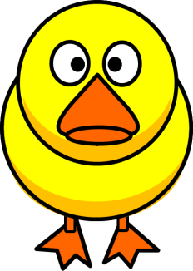
Ducks …
1 meow
2 woof
3 quack
Click on the right word

Slide 16
Hens …
1 cluck
2 moo
3 baa
Click on the right word

Slide 17





pig
hen
dog
Listen to the sounds and click the correct animal name.
cat
cow
sheep

Slide 18
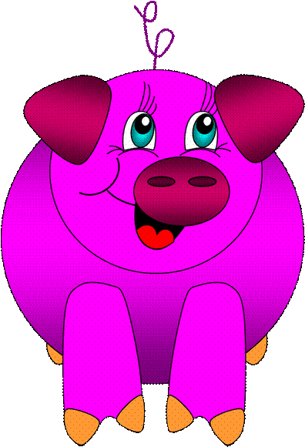
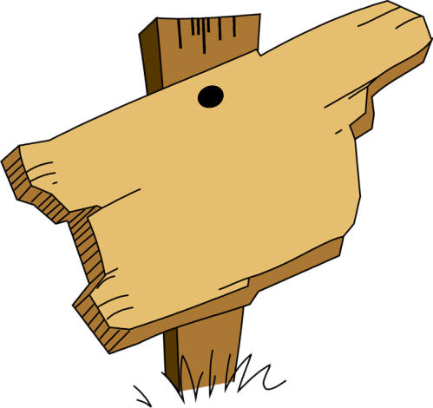
What do you hear?
hen
dog
cat
sheep
pig
Play
duck

Slide 19
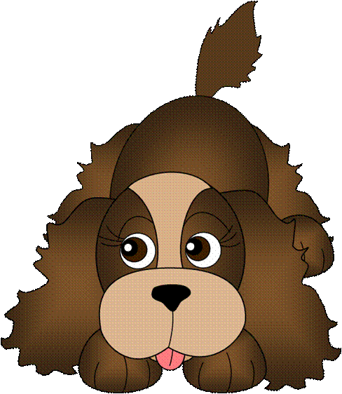
What do you hear?
cow
cat
dog
sheep
pig
Play
duck

Slide 20
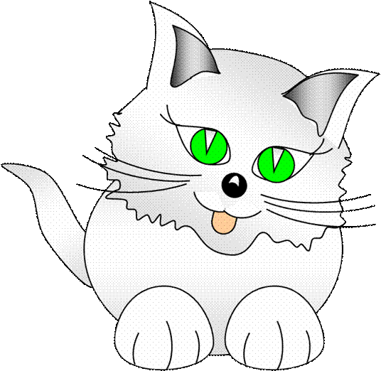
What do you hear?
cow
cat
dog
sheep
pig
Play
duck

Slide 21
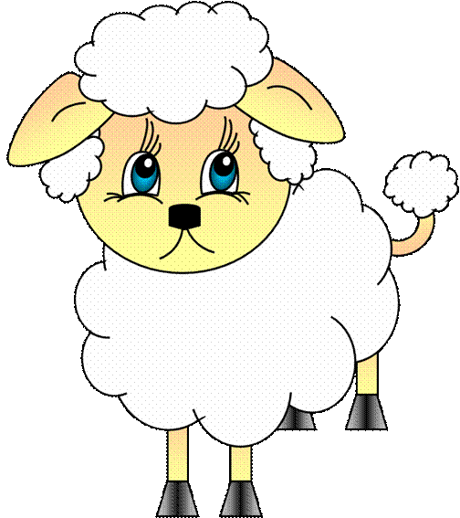
What do you hear?
cat
cow
dog
hen
sheep
Play
duck

Slide 22
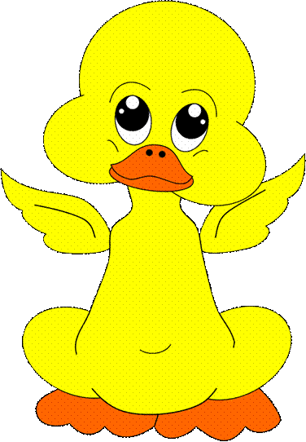
What do you hear?
cow
cat
dog
sheep
pig
Play
duck

Slide 23
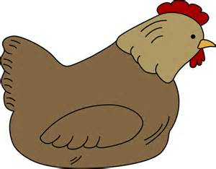
What do you hear?
cat
hen
cow
sheep
pig
Play
dog

Slide 24
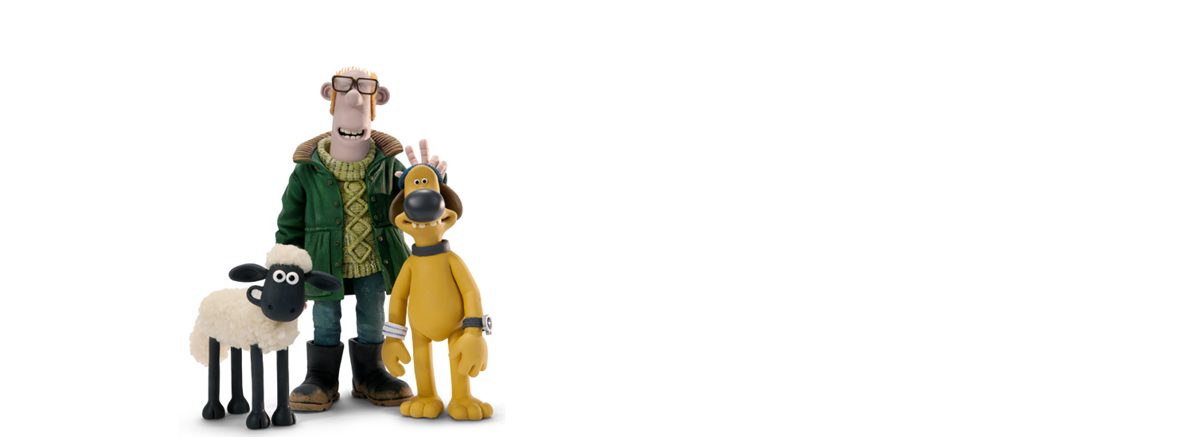
Lets sing a song
NEXT
farmer
My name is Bingo

Slide 25


How many?
THREE
FOUR
FIVE
There are four hens.
Correct!
NEXT

Slide 26


How many?
TEN
SEVEN
NINE
There are ten sheep.
Correct
NEXT

Slide 27

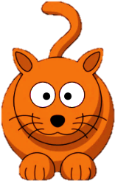
How many?
THREE
TWO
SIX
There are three cats.
Correct
NEXT

Slide 28


How many?
THREE
ONE
TWO
There are two dogs.
Correct
NEXT

Slide 29
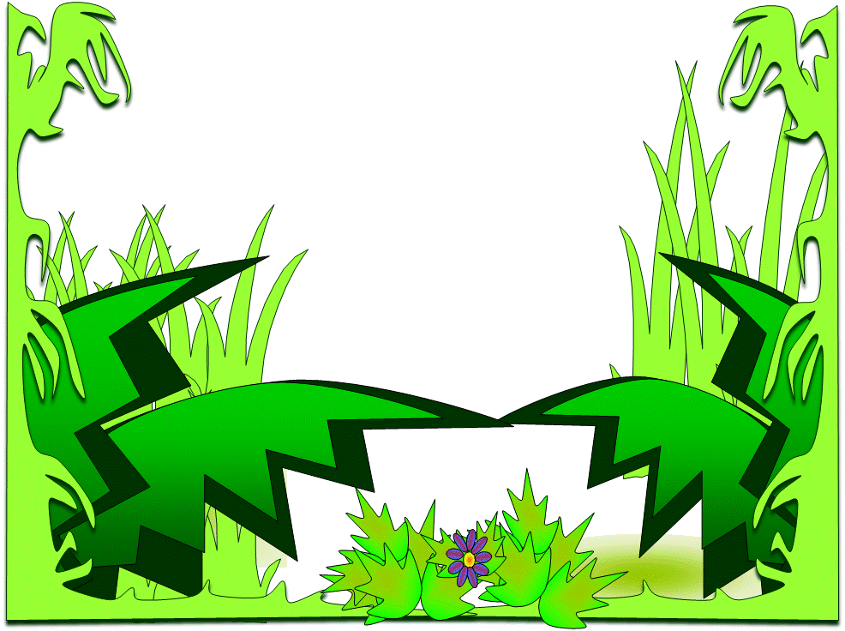


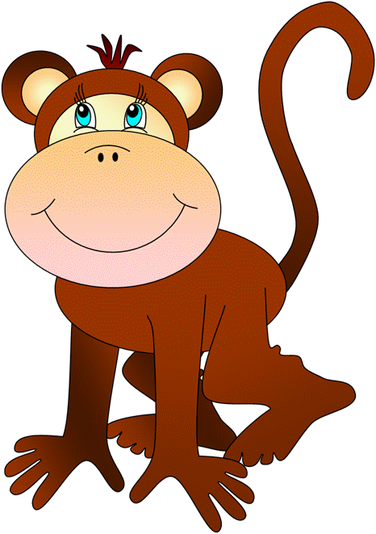
What do you hear?
1 dog
2 cat
4 monkey
3 tiger
6 bear
5 cow

Slide 30
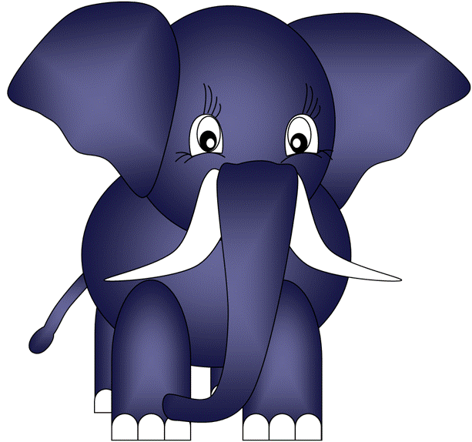
What do you hear?
1 lion
2 hen
4 tiger
3 bear
6 duck
5 elephant

Slide 31
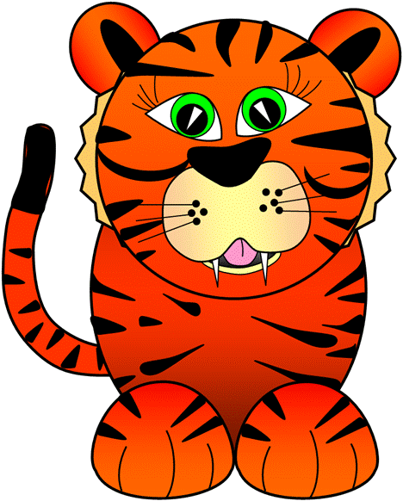
What do you hear?
3 bird
1 cow
4 monkey
2 tiger
6 pig
5 elephant

Slide 32
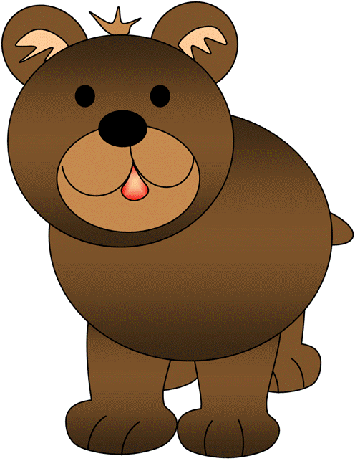
What do you hear?
1 cat
2 pig
4 monkey
3 banana
6 bear
5 hen

Slide 33




Animal sounds
Memory Game
lion

Slide 34









A B C D E
1
bear
dog
Animal Sounds
Memory Game
Match the
Picture + Sound
2
pig
sheep
3
duck
hen /
chicken
4
cat
cow

Slide 35









Animal do you hear? Game
1 frog =
2 dog =
3 cat =
4 lion =
5 duck =
6 cow =
7 monkey =
8 bee =
9 bird =
10 pig =
I hear a …
Yes / No

