Slide 1
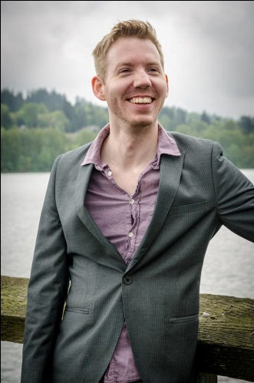
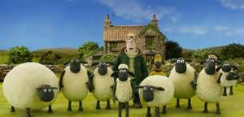
Look at teacher 看着老师 Kànzhe Lǎoshī Listen to teacher 听老师说 Tīng Lǎoshī shuō Answer teacher 回答老师 Huídá Lǎoshī Be quiet 安靜 Ānjìng Sit down 坐下 Zuò xià
Neil Teacher 外國老師 Wàiguó lǎoshī
You follow the rules and we have fun & watch video 你遵循规则，我们玩得开心，观看视频.. Nǐ zūnxún guīzé, wǒmen wán dé kāixīn & guānkàn shìpín
Shaun the sheep 小羊肖恩

